Slide 1
Remote Procedure Call
Outline
  Protocol Stack
  Presentation Formatting

Slide 2
RPC Timeline
Client
Server
Request
Blocked
Blocked
Computing
Reply
Blocked

Slide 3
RCP Components
Protocol Stack
  BLAST: fragments and reassembles large messages
  CHAN: synchronizes request and reply messages
  SELECT: dispatches request to the correct process
Stubs
Caller
Callee
(client)
(server)
Arguments
Return
Arguments
Return
value
value
Client
Server
stub
stub
Request
Reply
Request
Reply
RPC
RPC
protocol
protocol

Slide 4
Bulk Transfer (BLAST)
Sender
Receiver
Unlike AAL and IP, tries to recover from lost fragments
Strategy
  selective retransmission
  aka partial acknowledgements
Fragment 1
Fragment 2
Fragment 3
Fragment 4
Fragment 5
Fragment 6
SRR
Fragment 3
Fragment 5
SRR

Slide 5
BLAST Details
Sender:
  after sending all fragments, set timer DONE
  if receive SRR, send missing fragments and reset DONE
  if timer DONE expires, free fragments

Slide 6
BLAST Details (cont)
Receiver:
  when first fragments arrives, set timer LAST_FRAG
  when all fragments present, reassemble and pass up
  four exceptional conditions:
    if last fragment arrives but message not complete
      send SRR and set timer RETRY
    if timer LAST_FRAG expires
      send SRR and set timer RETRY
    if timer RETRY expires for first or second time
      send SRR and set timer RETRY
    if timer RETRY expires a third time
      give up and free partial message

Slide 7
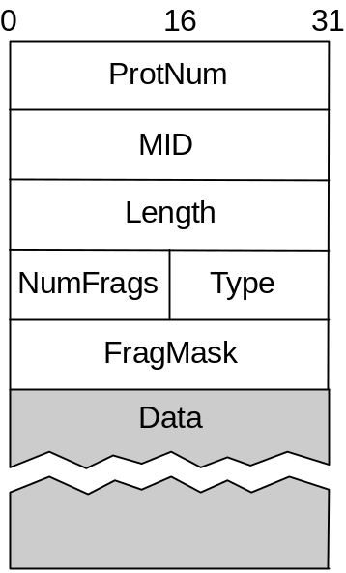
BLAST Header Format
MID must protect against wrap around
TYPE = DATA or SRR
NumFrags indicates number of fragments
FragMask distinguishes among fragments
  if Type=DATA, identifies this fragment
  if Type=SRR, identifies missing fragments

Slide 8
Request/Reply (CHAN)
Guarantees message delivery
Synchronizes client with server
Supports at-most-once semantics
Simple case Implicit Acks
Client
Server
Client
Server
Request
Request 1
ACK
Reply 1
Reply
Request 2
ACK
Reply 2
…

Slide 9
CHAN Details
Lost message (request, reply, or ACK)
  set RETRANSMIT timer
  use message id (MID) field to distinguish
Slow (long running) server
  client periodically sends “are you alive” probe, or
  server periodically sends “I’m alive” notice
Want to support multiple outstanding calls
  use channel id (CID) field to distinguish
Machines crash and reboot
  use boot id (BID) field to distinguish

Slide 10
CHAN Header Format
typedef struct {
u_short Type; /* REQ, REP, ACK, PROBE */
u_short CID; /* unique channel id */
int MID; /* unique message id */
int BID; /* unique boot id */
int Length; /* length of message */
int ProtNum; /* high-level protocol */
} ChanHdr;
typedef struct {
u_char type; /* CLIENT or SERVER */
u_char status; /* BUSY or IDLE */
int retries; /* number of retries */
int timeout; /* timeout value */
XkReturn ret_val; /* return value */
Msg *request; /* request message */
Msg *reply; /* reply message */
Semaphore reply_sem; /* client semaphore */
int mid; /* message id */
int bid; /* boot id */
} ChanState;

Slide 11
Synchronous vs Asynchronous Protocols
Asynchronous interface
xPush(Sessn s, Msg *msg)
xPop(Sessn s, Msg *msg, void *hdr)
xDemux(Protl hlp, Sessn s, Msg *msg)
Synchronous interface
xCall(Sessn s, Msg *req, Msg *rep)
xCallPop(Sessn s, Msg *req, Msg *rep, void *hdr)
xCallDemux(Protl hlp, Sessn s, Msg *req, Msg *rep)
CHAN is a hybrid protocol
  synchronous from above: xCall
  asynchronous from below: xPop/xDemux

Slide 12
chanCall(Sessn self, Msg *msg, Msg *rmsg){
ChanState *state = (ChanState *)self->state;
ChanHdr *hdr;
char *buf;
/* ensure only one transaction per channel */
if ((state->status != IDLE))
return XK_FAILURE;
state->status = BUSY;
/* save copy of req msg and ptr to rep msg*/
msgConstructCopy(&state->request, msg);
state->reply = rmsg;
/* fill out header fields */
hdr = state->hdr_template;
hdr->Length = msgLen(msg);
if (state->mid == MAX_MID)
state->mid = 0;
hdr->MID = ++state->mid;

Slide 13
/* attach header to msg and send it */
buf = msgPush(msg, HDR_LEN);
chan_hdr_store(hdr, buf, HDR_LEN);
xPush(xGetDown(self, 0), msg);
/* schedule first timeout event */
state->retries = 1;
state->event = evSchedule(retransmit, self, state->timeout);
/* wait for the reply msg */
semWait(&state->reply_sem);
/* clean up state and return */
flush_msg(state->request);
state->status = IDLE;
return state->ret_val;
}

Slide 14
retransmit(Event ev, int *arg){
Sessn s = (Sessn)arg;
ChanState *state = (ChanState *)s->state;
Msg tmp;
/* see if event was cancelled */
if ( evIsCancelled(ev) ) return;
/* unblock client if we've retried 4 times */
if (++state->retries > 4) {
state->ret_val = XK_FAILURE;
semSignal(state->rep_sem);
return;
}
/* retransmit request message */
msgConstructCopy(&tmp, &state->request);
xPush(xGetDown(s, 0), &tmp);
/* reschedule event with exponential backoff */
evDetach(state->event);
state->timeout = 2*state->timeout;
state->event = evSchedule(retransmit, s, state->timeout);
}

Slide 15
chanPop(Sessn self, Sessn lls, Msg *msg, void *inHdr)
{
/* see if this is a CLIENT or SERVER session */
if (self->state->type == SERVER)
return(chanServerPop(self, lls, msg, inHdr));
else
return(chanClientPop(self, lls, msg, inHdr));
}

Slide 16
chanClientPop(Sessn self, Sessn lls, Msg *msg, void *inHdr)
{
ChanState *state = (ChanState *)self->state;
ChanHdr *hdr = (ChanHdr *)inHdr;
/* verify correctness of msg header */
if (!clnt_msg_ok(state, hdr))
return XK_FAILURE;
/* cancel retransmit timeout event */
evCancel(state->event);
/* if ACK, then schedule PROBE and exit*/
if (hdr->Type == ACK)
{
state->event = evSchedule(probe, s, PROBE);
return XK_SUCCESS;
}
/* save reply and signal client */
msgAssign(state->reply, msg);
state->ret_val = XK_SUCCESS;
semSignal(&state->reply_sem);
return XK_SUCCESS;
}

Slide 17
Dispatcher (SELECT)
Dispatch to appropriate procedure
Synchronous counterpart to UDP
Client
Server
Caller
Callee
xCall
xCallDemux
SELECT
SELECT
xCall
xCallDemux
CHAN
CHAN
xPush
xDemux
xPush
xDemux
Address Space for Procedures
  flat: unique id for each possible procedure
  hierarchical: program + procedure number

Slide 18
Example Code
Client side
static XkReturn
selectCall(Sessn self, Msg *req, Msg *rep)
{
SelectState *state=(SelectState *)self->state;
char *buf;
buf = msgPush(req, HLEN);
select_hdr_store(state->hdr, buf, HLEN);
return xCall(xGetDown(self, 0), req, rep);
}
Server side
static XkReturn
selectCallPop(Sessn s, Sessn lls, Msg *req, Msg *rep, void *inHdr)
{
return xCallDemux(xGetUp(s), s, req, rep);
}

Slide 19
Simple RPC Stack
SELECT
CHAN
BLAST
IP
ETH

Slide 20
VCHAN: A Virtual Protocol
static XkReturn
vchanCall(Sessn s, Msg *req, Msg *rep)
{
Sessn chan;
XkReturn result;
VchanState *state=(VchanState *)s->state;
/* wait for an idle channel */
semWait(&state->available);
chan = state->stack[--state->tos];
/* use the channel */
result = xCall(chan, req, rep);
/* free the channel */
state->stack[state->tos++] = chan;
semSignal(&state->available);
return result;
}

Slide 21
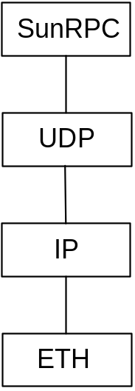
SunRPC
IP implements BLAST-equivalent
  except no selective retransmit
SunRPC implements CHAN-equivalent
  except not at-most-once
UDP + SunRPC implement SELECT-equivalent
  UDP dispatches to program (ports bound to programs)
  SunRPC dispatches to procedure within program

Slide 22
SunRPC Header Format
XID (transaction id) is similar to CHAN’s MID
Server does not remember last XID it serviced
Problem if client retransmits request while reply is in transit
0
31
0
31
XID
XID
MsgType = CALL
MsgType = REPLY
RPCVersion = 2
Status = ACCEPTED
Program
Data
Version
Procedure
Credentials (variable)
Verifier (variable)
Data

Slide 23
Presentation Formatting
Marshalling (encoding) application data into messages
Unmarshalling (decoding) messages into application data
Data types we consider
  integers
  floats
  strings
  arrays
  structs
Application
Application
data
data
Presentation
Presentation
encoding
decoding
Message
Message
…
Message
Types of data we do not consider
  images
  video
  multimedia documents

Slide 24
Difficulties
Representation of base types
  floating point: IEEE 754 versus non-standard
  integer: big-endian versus little-endian (e.g., 34,677,374)
Compiler layout of structures
(2)
(17)
(34)
(126)
Big-
endian
00000010
0
0
0
1
0
0
0
1
0
0
1
0
0
0
1
0
0
1
1
1
1
1
1
0
(126)
(34)
(17)
(2)
Little-
endian
0
1
1
1
1
1
1
0
0
0
1
0
0
0
1
0
0
0
0
1
0
0
0
1
0
0
0
0
0
0
1
0
High
Low
address
address

Slide 25
Taxonomy
Data types
  base types (e.g., ints, floats); must convert
  flat types (e.g., structures, arrays); must pack
  complex types (e.g., pointers); must linearize
Conversion Strategy
  canonical intermediate form
  receiver-makes-right (an N x N solution)
Application data structure
Marshaller

Slide 26
Taxonomy (cont)
Tagged versus untagged data
Stubs
  compiled
  interpreted
type =
len = 4
value =
417892
INT
Interface
descriptor for
Call P
Procedure P
P
Arguments
Specification
Arguments
Client
Code
Stub
Code
Server
stub
compiler
stub
Marshalled
Marshalled
arguments
arguments
RPC
RPC
Message

Slide 27
eXternal Data Representation
(XDR)
Defined by Sun for use with SunRPC
C type system (without function pointers)
Canonical intermediate form
Untagged (except array length)
Compiled stubs

Slide 28
#define MAXNAME 256;
#define MAXLIST 100;
struct item {
int count;
char name[MAXNAME];
int list[MAXLIST];
};
bool_t
xdr_item(XDR *xdrs, struct item *ptr)
{
return(xdr_int(xdrs, &ptr->count) &&
xdr_string(xdrs, &ptr->name, MAXNAME) &&
xdr_array(xdrs, &ptr->list, &ptr->count,
MAXLIST, sizeof(int), xdr_int));
}
Count
Name
3
7
J
O
H
N
S
O
N
List
3
4
9
7
8
3
2
1
2
6
5

Slide 29
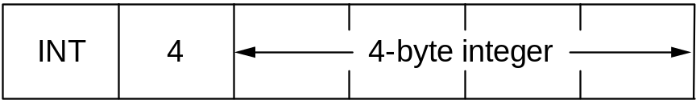
Abstract Syntax Notation One (ASN-1)
An ISO standard
Essentially the C type system
Canonical intermediate form
Tagged
Compiled or interpretted stubs
BER: Basic Encoding Rules
(tag, length, value)
type
length
type
length
value
type
length
value
value

Slide 30
Network Data Representation
(NDR)
Defined by DCE
Essentially the C type system
Receiver-makes-right (architecture tag)
Individual data items untagged
Compiled stubs from IDL
4-byte architecture tag
  IntegerRep
    0 = big-endian
    1 = little-endian
  CharRep
    0 = ASCII
    1 = EBCDIC
  FloatRep
    0 = IEEE 754
    1 = VAX
    2 = Cray
    3 = IBM

